Slide 1
Anisotropies of Cosmic Microwave Background and Its Polarization
Taup2007@Sendai
A New & Ultimate Tool for Cosmology and Particle Physics
Naoshi Sugiyama
Nagoya University

Slide 2
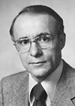
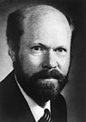
Cosmic Microwave Background
Direct Evidence of Big Bang
Found in 1964 by Penzias & Wilson
Very Precise Black Body by COBE (J.Mather)
John Mather | Arno Allan Penzias | Robert Woodrow Wilson

Slide 3
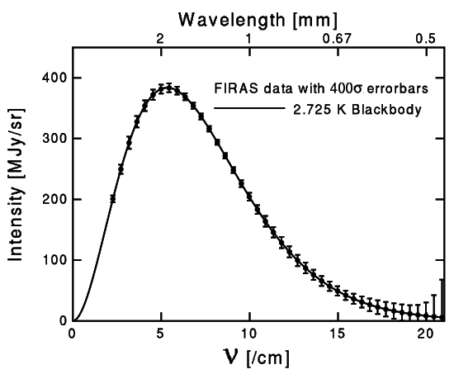
４００σ！
Perfect Black Body
NASA/GSFC提供
Frequency
Notes:
これがＣＯＢＥ衛星が得た、放射強度の振動数、波長依存性です。ここで誤差棒のついている点が測定値、実線が黒体放射です。誤差は４００倍に拡大してあります。ほぼ完璧といってよい黒体放射であることがわかります。宇宙マイクロ波背景放射は、黒体放射だったのです。

Slide 4
Temperature Fluctuations of Cosmic Microwave Background
Found by COBE/DMR (G.Smoot), measured in detail by WMAP
Structure at 380,000 yrs (z=1100)
Recombination epoch of Hydrogen atoms
Missing Link between Inflation (10⁻³⁶s) and Present (13.7 Billion yrs)
Ideal Probe of Cosmological Parameters
Typical Sizes of Fluctuation Patters are Theoretically Known as Functions of Various Cosmological Parameters

Slide 5
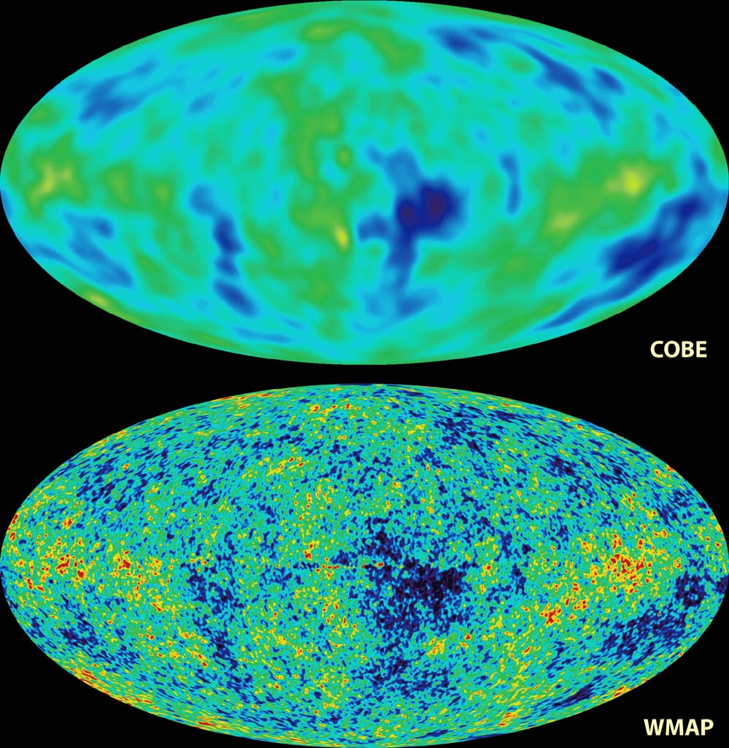
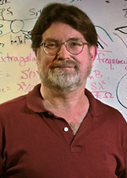
COBE & WMAP
George Smoot

Slide 6
Physical Processes to Induce CMB Fluctuations
Originated from Quantum Fluctuations at the Inflation Epoch
Almost Scale Free (Invariant Spectrum):
Dominated by Gravitational Redshift (Sachs-Wolfe effect) on Large Scales
Acoustic Oscillations Play an Important Role on Intermediate Scales
Diffusion Damping works on Small Scales
Statistical Quantity: Angular Power Spectrum C_{l}

Slide 7
WMAP
Acoustic Oscillations
COBE
COBE
Gravitaional Redshift
(Sachs-Wolfe)
Diffusion damping
Large
10°
1°
10min
Small

Slide 8
What control CMB Anisotropies
Sound Velocity at Recombination
Baryon Density: Ω_{B}h²
Horizon Size at Recombination
Matter Density: Ω_{M}h²
Radiative Transfer between Recombination and Present
Space Curvature: Ω_{K}
Initial Condition of Fluctuations
If Power law, its index n (P(k)∝k^{n})

Slide 9
M
small
Ω_{M}h²
large

Slide 10
M
large
Ω_{B}h²
large
small
small

Slide 11
Open:
Concave lens space
Image becomes small
Shifts to larger l

Slide 12
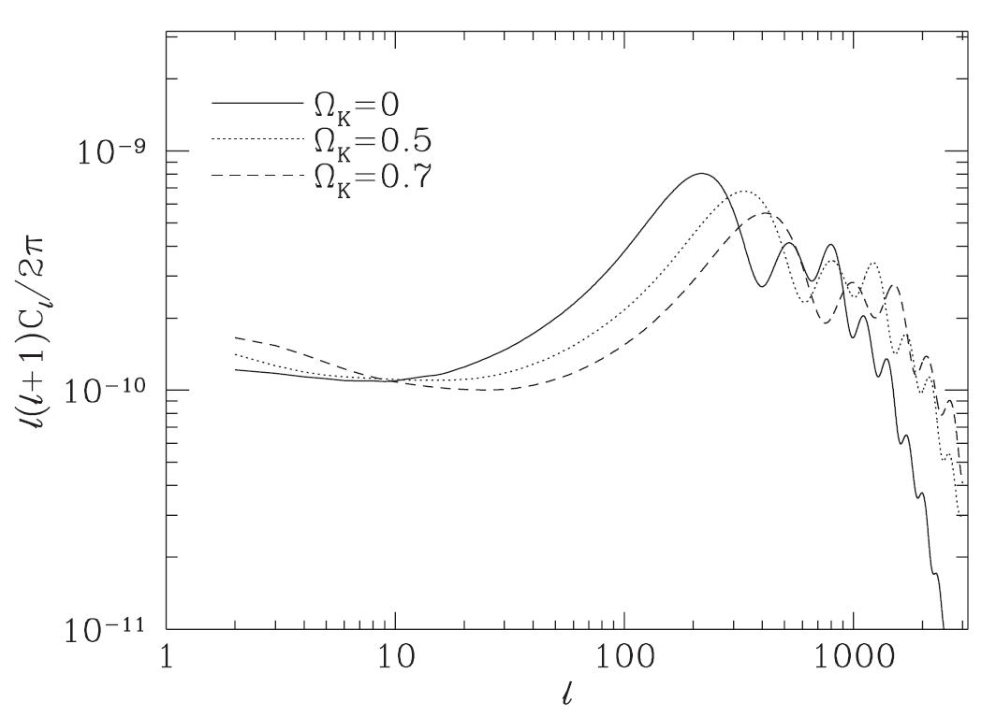
Negative
curvature

Slide 13
Observations
COBE
Clearly see large scale (low l ) tail
angular resolution was too bad to resolve peaks
Balloon borne/Grand Base experiments
Boomerang, MAXMA, CBI, Saskatoon, Python, OVRO, etc
See some evidence of the first peak, even in Last Century!
WMAP

Slide 14
CMB observations
by 1999

Slide 15
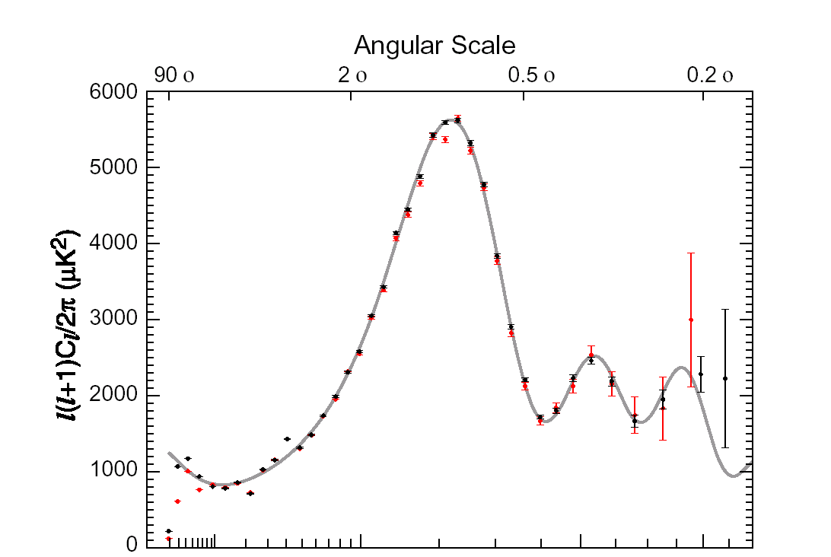
WMAP
Observation
1st yr
3 yr

Slide 16
WMAP Temperature Power Spectrum
Clear existence of large scale Plateau
Clear existence of Acoustic Peaks (upto 2nd or 3rd )
3rd Peak has been seen by 3 yr data
Consistent with
Inflation and Cold Dark Matter Paradigm
One Puzzle:
Unexpectedly low Quadrupole (l=2)

Slide 17
Measurements of Cosmological Parameters by WMAP
Ω_{B}h² =0.02229±0.00073 (3% error!)
Ω_{M}h² =0.128 ±0.008
Ω_{K}=0.014±0.017 (with H=72±8km/s/Mpc)
n=0.958 ±0.016
Spergel et al.
WMAP 3yr alone
Dark Energy
76%
Dark Matter
20%
Baryon 4%

Slide 18
Finally Cosmologists Have the “Standard Model!”
But…
76% of total energy/density is unknown: Dark Energy
20% of total energy/density is unknown: Dark Matter
Dark Energy is perhaps a final piece of the puzzle
for cosmology
equivalent to Higgs for particle physics

Slide 19
Dark Energy
How do we determine Ω_{Λ}=0.76?
Subtraction!: Ω_{Λ}= 1- Ω_{M} - Ω_{K}
Q: Can CMB provide a direct probe of
Dark Energy?

Slide 20
Dark Energy
CMB can be a unique probe of dark energy
Temperature Fluctuations are generated by the growth (decay) of the Large Scale Structure (z~1)
Integrated Sachs-Wolfe Effect
Photon gets blue
Shift due to decay
E=|Ψ₁-Ψ₂|
Ψ₂
Ψ₁
Gravitational Potential of Structure
decays due to Dark Energy

Slide 21
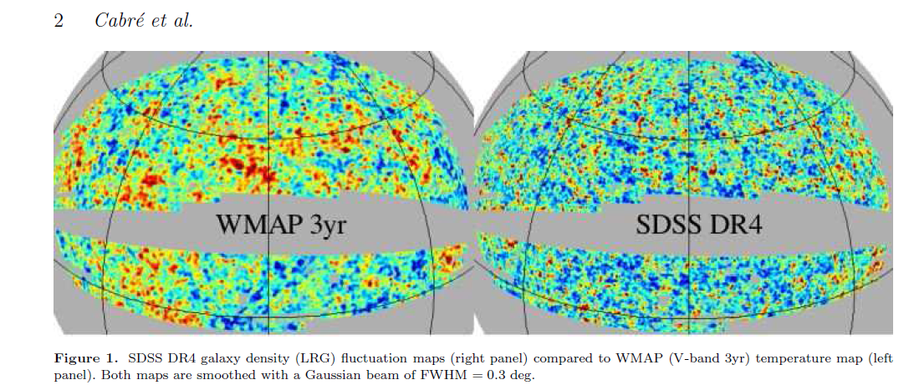

Slide 22
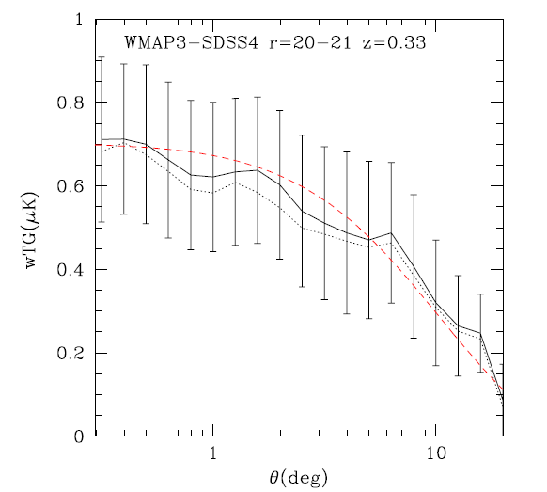

Slide 23
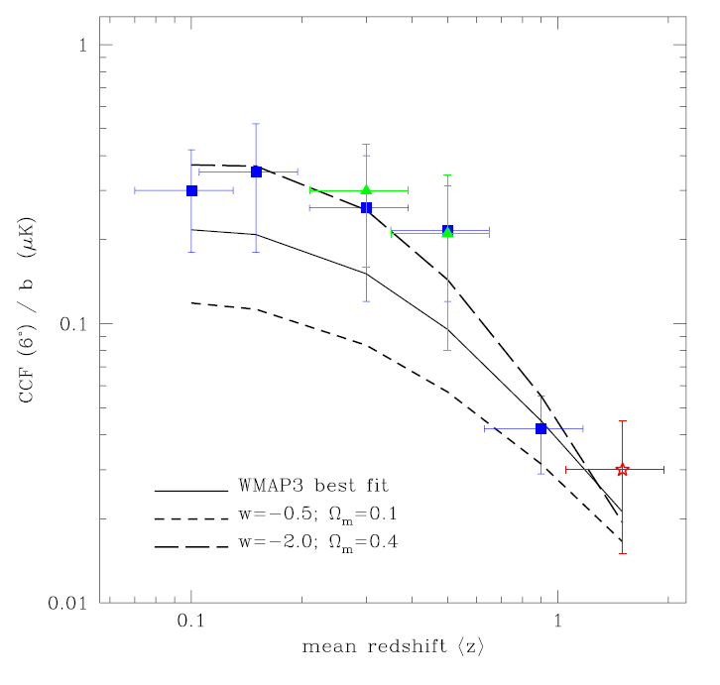
Various Samples of
CMB-LSS Cross-Correlation
as a function of redshift
w=-0.5
w=-1
w=-2
Measure w!
Less
Than
10min

Slide 24
What else can we learn about fundamental physics from WMAP or future Experiments?
Properties of Neutrinos
Numbers of Neutrinos
Masses of Neutrinos
Fundamental Physical Constants
Fine Structure Constant
Gravitational Constant

Slide 25
Constraints on Neutrino Properties
Neutrino Numbers N_{eff} and mass m_{ν}
Change N_{eff} or m_{ν} modifies the peak heights and locations of CMB spectrum.

Slide 26
CMB Angular Power Spectrum
Theoretical Prediction
Measure the family number at z=1000

Slide 27
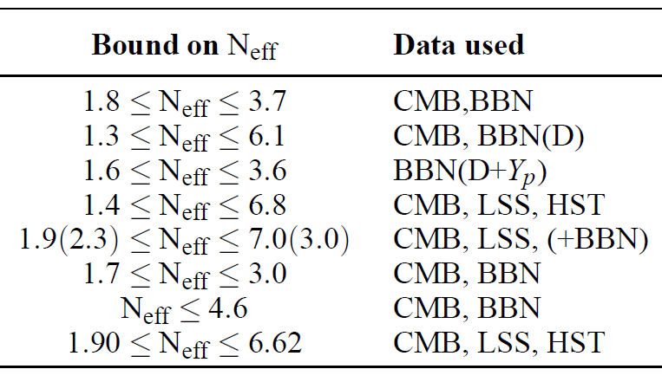
Unfortunately, difficult to set constraints on N_{eff} by CMB alone: Need to combine with other data
P. Serpico et al., (2004)
A. Cuoco et al., (2004)
P. Crotty et al., (2003)
S. Hannestad, (2003)
V. Barger et al., (2003)
R. Cyburt et al. (2005)
E. Pierpaoli (2003)
BBN: Big Bang Nucleothynthesis
LSS: Large Scale Structure
HST: Hubble constant from Hubble Space Telescope

Slide 28
For Neutrino Mass, CMB with Large Scale Structure Data provide stringent limit since Neutrino Components prevent galaxy scale structure to be formed due to their kinetic energy

Slide 29
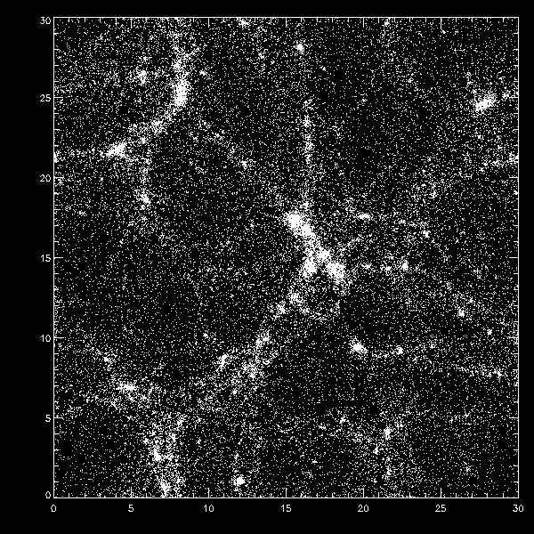
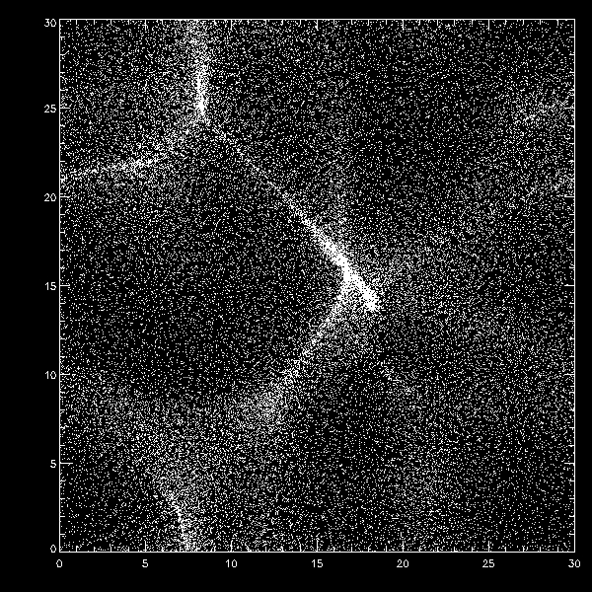
Cold Dark Matter
Neutrino as Dark Matter
(Hot Dark Matter)
Numerical Simulation

Slide 30
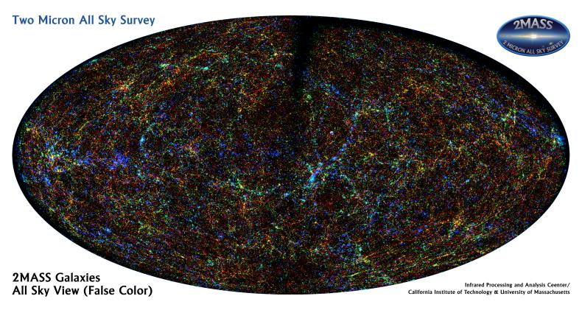

Slide 31
Constraints on m_{ν} and N_{eff}
WMAP 3yr Data paper by Spergel et al.
Less
Than
10min

Slide 32
Constraints on Fundamental Physical Constants
Fine Structure Constant α
There are debates whether one has seen variation of α in QSO absorption lines
Time variation of α affects on recombination process and scattering between CMB photons and electrons
WMAP 3yr data set:
-0.039<Δα/α<0.010 (by P.Stefanescu 2007)

Slide 33
Gravitational Constant G
G can couple with Scalar Field (c.f. Super String motivated theory)
Alternative Gravity theory: Brans-Dicke /Scalar-Tensor Thoery
G ∝ 1/φ (scalar filed)
G may be smaller in the early epoch
WMAP data set constrain: |ΔG/G|<0.05 (2σ) (Nagata, Chiba, N.S.)

Slide 34
Polarization
Scattering off electrons & CMB quadrupole anisotropies
produce linear polarization

Slide 35
Incoming
Electro-Magnetic
Field
Same Flux
No-Preferred Direction
UnPolarized
Same
Flux
Electron
scattering
Homogeneously Distributed Photons

Slide 36
Incoming
Electro-Magnetic
Field
Weak Flux
Preferred Direction
Polarized
Strong
Flux
Electron
scattering
Photon Distributions with the Quadrupole Pattern

Slide 37
Why is Polarization Important?
Provide information of last scattering of photons
Reionization of the Universe due to First Stars
Better estimation for Cosmological Parameters
Sensitive to Gravity Wave (Tensor Mode Fluctuations)

Slide 38
Two Independent Modes
E-mode (Electronic), Divergence
Density Fluctuations associated to Structure formation induce only this mode
B-mode (Magnetic), Rotation
Vector (rotational ) Fluctuations: decaying mode
Tensor (Gravitational Wave) Fluctuations
B-mode polarization is a unique probe of
Gravitational Wave generated during Inflation
c.f. No way to separate two modes in Temperature
Fluctuations

Slide 39
E-mode
2 independent
parity modes
B-mode
Seljak

Slide 40
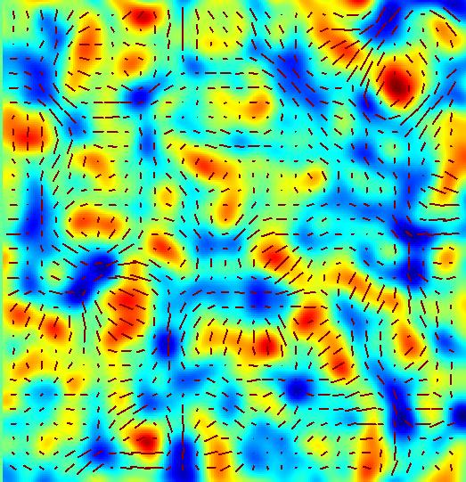
E-mode
Seljak
Scalar Perturbations only produce E-mode

Slide 41
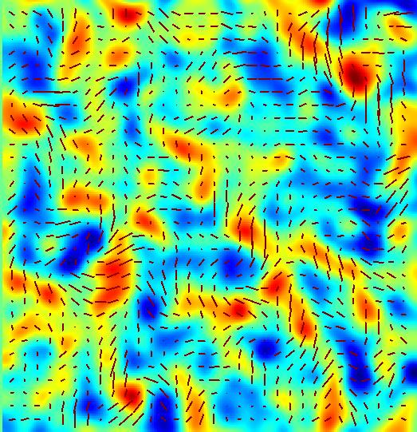
B-mode
Tensor perturbations produce both E- and B- modes

Slide 42
Scalar Component

Slide 43
Tensor Component
Hu & White

Slide 44
We can Prove Inflation from B-mode Polarization
Consistency Relation
n_{T}: Tensor Power Law Index
A_{T}: Tensor Amplitude
A_{S}: Scalar Amplitude
If we can find B-mode, we can measure tensor spectrum (n_{T} & A_{T}), and test consistency relation

Slide 45
Observations
Very difficult to detect since typically amplitude of polarization is factor 10 smaller than temperature fluctuations
First Detection of E-mode Polarization was from DESI experiments (J.Carlstrom’s group)
Boomerang Experiment (Balloon at Antarctica)
WMAP made clear detection of E-mode polarization in the all sky map (3yr data)

Slide 46
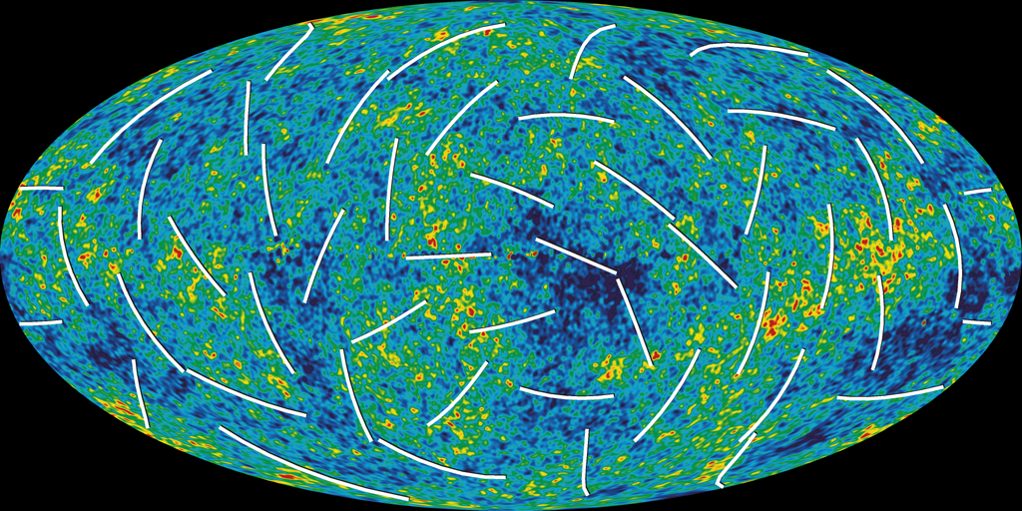

Slide 47
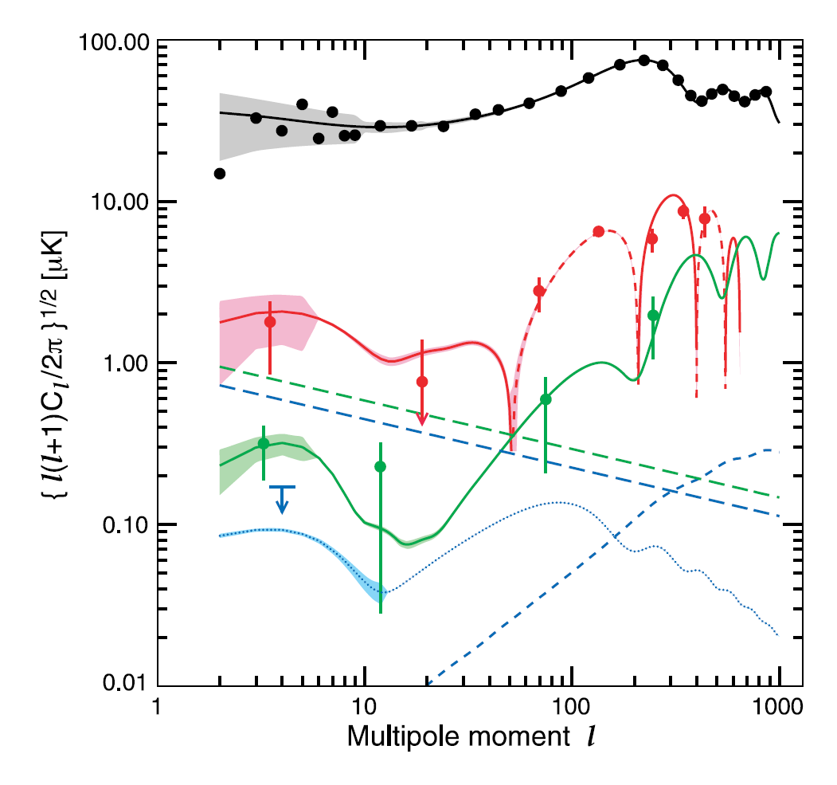
Temperature
Temperature-E-mode
E-mode
B-mode
(upper bound)

Slide 48
Polarization for WMAP is Temperature Fluctuations for COBE anyway, detect (E-mode)!
But only upper bound for B-mode Polarization

Slide 49
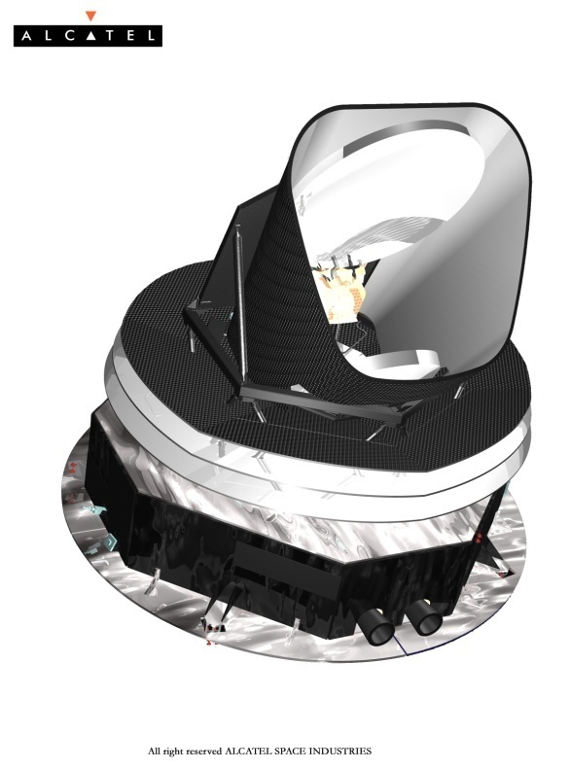
Ongoing, Forthcoming Experiments
PLANCK is coming soon:
More Frequency Coverage
Better Angular Resolution
Other Experiments
Ongoing Ground-based:
CAPMAP, CBI, DASI, KuPID, Polatron
Upcoming Ground-based:
AMiBA, BICEP, PolarBear, QUEST, CLOVER
Balloon:
Archeops, BOOMERanG, MAXIPOL
Space:
Inflation Probe

Slide 50
Polarization is the next target after
Temperature Fluctuations

Slide 51
It must be a Hat!

Slide 53
Temperature
Power Spectrum
Polarization
Power Spectrum

Slide 54
“What is essential is invisible to the eye.”
?
Temperature
Power Spectrum
Polarization
Power Spectrum
Dark Matter, Dark Energy
?
Gravity Wave

Slide 55
Reionization
Liu et al. ApJ 561 (2001)
First Order Effect

Slide 56
E-mode Polarization
Scalar Perturbations
Tensor Perturbations
Reionization
B-mode Polarization
Tensor Perturbations
Reionization
Gravitational Lensing from E-mode

Slide 57
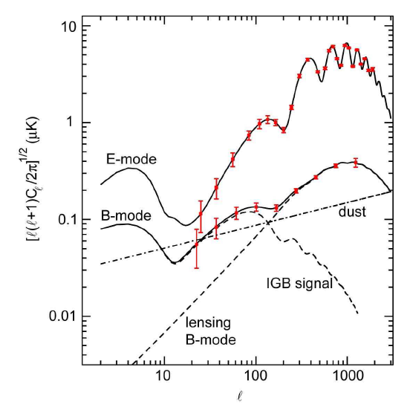
Oxley et al. astroph/0501111

Slide 58
Power Spectrum
C_{l}: two dimensional power spectrum
l=π/θ multipole
COBE: l < 20 (7 degree)
WMAP: l < 800
COBE
Different Physical Processes on different scales
gravitational redshift on large scale (Sachs-Wolfe)
acoustic oscillations on intermediate scale
diffusion damping on small scale (Silk damping)

Slide 59
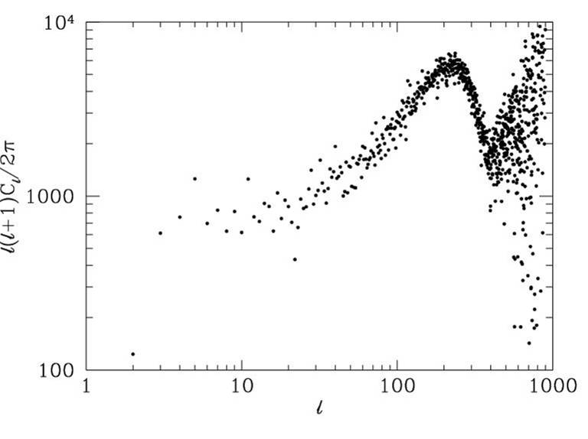
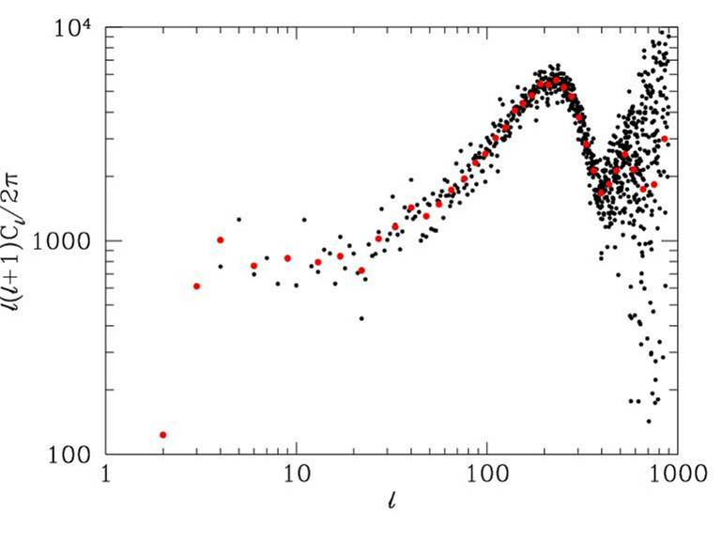
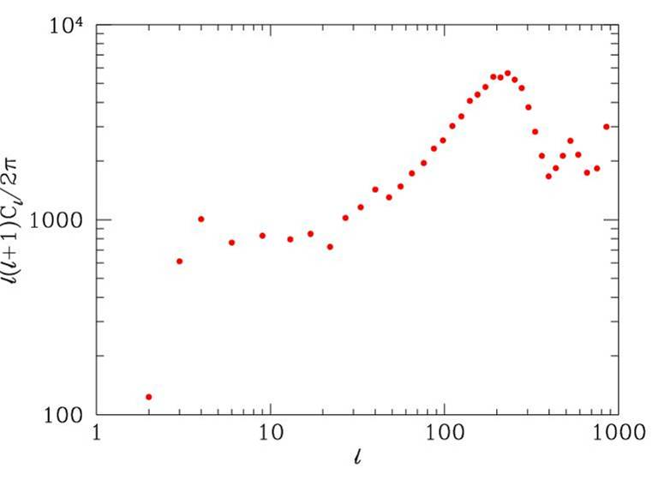

Slide 60
Neutrino Mass mν
Present Density Parameter
Change the matter-radiation ratio near the recombination epoch, if m ~ a few eV
Constraints from Cosmic Microwave Background
Neutrino Components prevent galaxy scale structure to be formed due to their kinetic energy
Constraints from Large Scale Structure

Slide 61
QSO absorption line
δα = -0.72±0.18×10⁻⁵
0.5 < z < 3.5
Webb et al.

Slide 62
Influence on CMB
Thomson Scattering:
dτ/dt≡x_{e}n_{e}σ_{T}
τ: optical depth, x_{e}: ionization fraction
n_{e}: total electron density, σ_{T}: cross section

Slide 63
If α is changed
1) σ_{T}∝α² is changed
2) Temperature dependence of x_{e} i.e., temperature
dependence of recombination preocess is modified
For example, 13.6eV = α²m_{e}c²/2 is changed!
If α was smaller, recombination became later
If δα=±5%, Δz~100

Slide 64
Flat, Ω_{M}=0.3, h=0.65, Ω_{B}h²=0.019
Ionization fraction
δα=-0.05
δα=0.05

Slide 65
δα=0.05
δα=-0.05
Temperature Fluctuation
Peaks shift to smaller l for smaller α
since the Universe was larger at recombination

Slide 66
P. Stefanescu (2007)
-0.039<Δ_{α}<0.010,

Slide 67
Varying G and CMB anisotropies
Brans-Dicke / Scalar-Tensor Theory
G ∝ 1/φ (scalar filed)
: G may be smaller in the early epoch
Stringent Constraint from Solar-system
: must be very close to General Relativity
BUT, it’s not necessarily the case
in the early universe

Slide 68
G₀/G

Slide 69
If G was larger in the early universe,
the horizon scale became smaller
c/H = c√(3/8πGρ)
Peaks shift to larger l

Slide 70
larger G
Nagata, Chiba, N.S.

Slide 72
We have hope to determine
cosmological parameters together with
the values of fundamental quantities,
i.e., α, G
at the recombination epoch
by measuring CMB anisotropies

