Slide 1
TAUP Conference @ Sendai
Sep 11 2007
Cosmic rays emitted by PBHs in a 5D RS braneworld
Yuuiti Sendouda
(Yukawa Inst., Kyoto)
with
S. Nagataki (YITP), K. Kohri (Lancaster),
K. Sato (Tokyo, RESCEU)

Slide 2
Overview

Slide 3
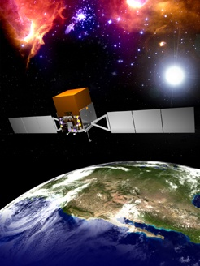

Strategy
Cosmic-ray observations
Modified theories of
formation and evaporation
of PBHs
Exotic models for Universe
Now, Braneworld

Slide 4
What to do
Too many PBHs would disturb standard cosmology
Cosmic-ray spectra differently dependent on extra dimension
Implications to braneworld and PBHs
Gamma-ray
Antiproton

Slide 5
Braneworld and PBHs

Slide 6



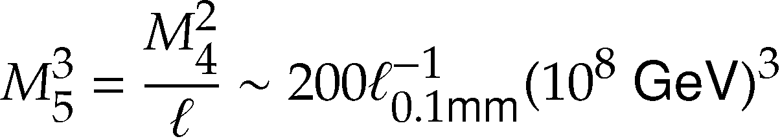
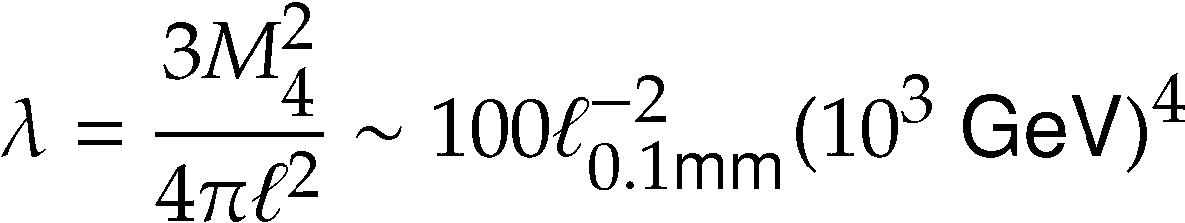
RS2 Braneworld
[Randall & Sundrum (1999a,b)]
Warped 5D metric
Bulk: Anti-
de Sitter (Λ<0)
4D on
large scales
ℓ . 0.1mm
Tension λ > 0
+Matter T_{μν}
5D gravity
below ℓ
Scales

Slide 7
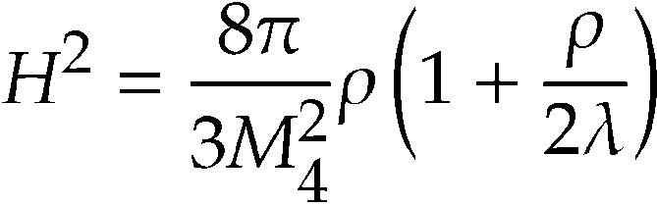
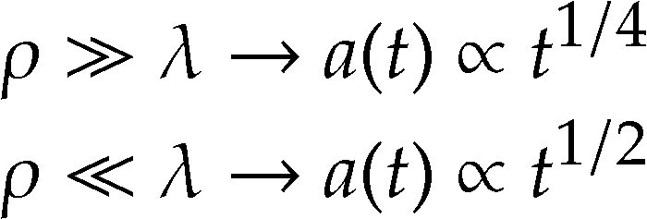
Cosmology
Friedmann eq.
ρ / a⁻⁴
Inflation
a(t)
2 distinctive epochs in RD
V ~ const. À λ
PBHs form
Matter
5D RD
t
ℓ

Slide 8
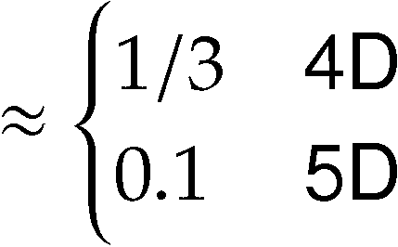
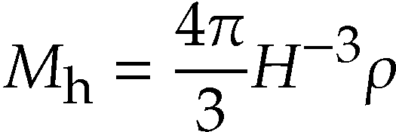

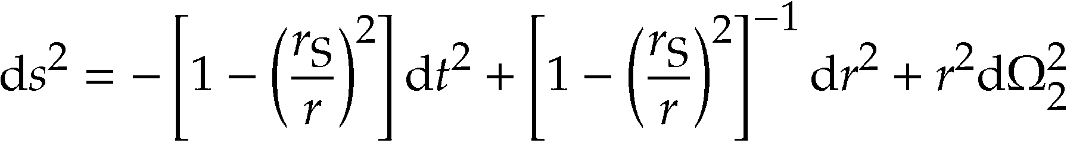
Primordial Black Hole
Carr (1975)
[Carr (1975), Guedens et al. (2002), Kawasaki (2004)]
In RD: Jeans length ~ Hubble radius ~ Schwarzschild radius
a(t)/k
δ
k = aH
t = t_{h}
BH
δ > δ_{c}
H(t)⁻¹ / t
5D Schwarzschild (r_{S}¿ℓ)
Notes:
閉じた領域が膨張から収縮に転じるときの最大半径>Jeans長

Slide 9
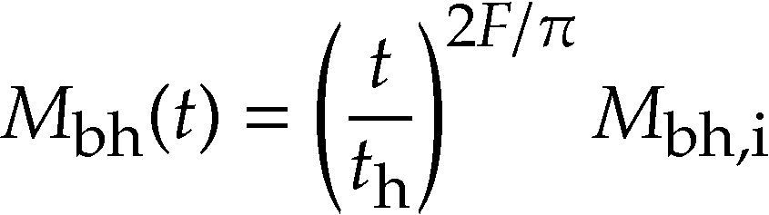
Accretion
[Guedens et al., Majumdar (2002)]
Radiation accretes due to “slow” expansion in 5d era
Brane
ρ(t)
Fcdt
Efficiency (0 < F < 1)
Mass growth

Slide 10
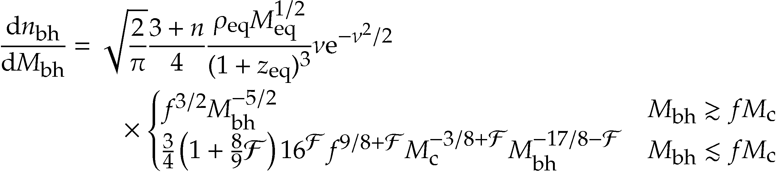
Primordial Mass Function
Accretion leads
to a huge increase
α_{i}: Initial PBH abundance
n=1.60
(Normalised at Lyα Forest)
Formula to calculate from inflationary perturbation
[YS et al., JCAP 0606 (2006) 003]
“Tilt”
Scale invariant

Slide 11
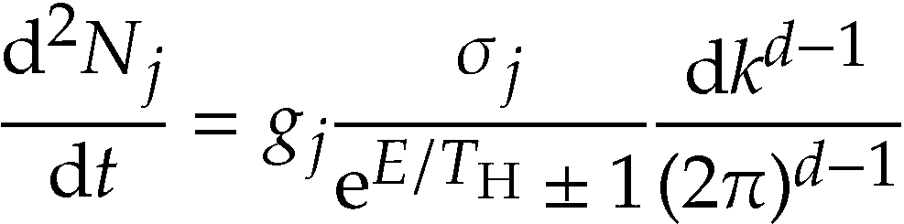

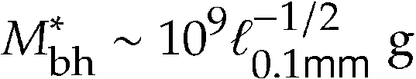

Hawking Radiation
Black body
KK graviton
S³
4D particles
S²
Temperature and mass of a “critical” PBH lifetime being 13.7Gyr
D=5 (RS)
D=4
¿

Slide 12
Galactic Antiprotons
[YS et al., PRD 71 (2005) 063512]

Slide 13
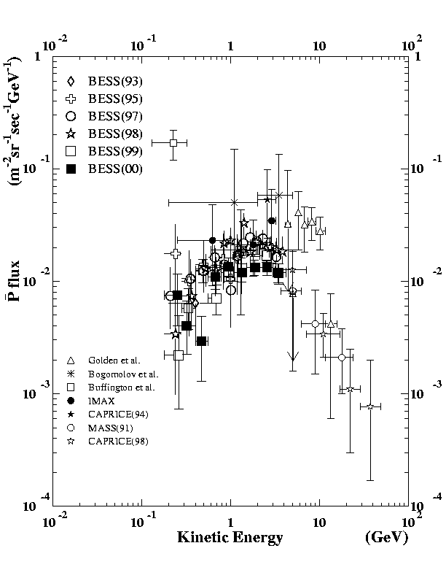

Observations
Excess?
[Asaoka (2002)]
http://www.kek.jp/newskek/2002/mayjun/bess1.html

Slide 14
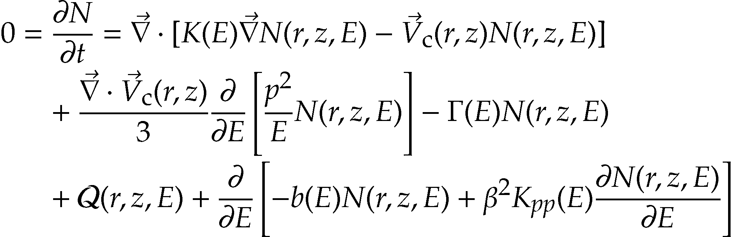
Propagation
z
B
Source
  NFW density profile
  QCD Jets treated with
  PYTHIA
_
_
p
secondary
p
primary
p
¯
r
Convection
Solar wind
Diffusion eq
[Ginzburg, Khazan & Ptuskin (1980), Berezinskii et al. (1991)]
[Webber, Lee & Gupta (1992)]
(+Solar modulation)

Slide 15
Typical Flux
Fitted to solar-minimum data
Positive detection?
No effect from extra dim?

Slide 16
Extra-dim Dependence
Mass function (present-day)
Flux Φ
ℓ small
M*
ℓ large
Diffusion
α_{i} is same
E₀
T_{H} & GeV
Contribution only from those currently evaporating
But spectrum unchanged
Flux proportional to →decreasing function of ℓ

Slide 17
Constraints on α_{i} or ℓ
Gα_{i} =
Large ℓ= weaker bound on PBH
○
Extra dim (ℓ/l₄)
×
Accretion (F)
Density contrast G » 10⁵

Slide 18
Extragalactic X/γ-ray
Background
[YS et al., PRD 68 (2003) 103510]

Slide 19

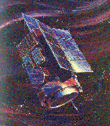
Observations
[Strong et al. (2003)]
keV
MeV
GeV
http://cossc.gsfc.nasa.gov/docs/cgro/images/home/Cartoon_CGRO.jpg
http://heasarc.gsfc.nasa.gov/Images/heao1/heao1_sat_small2.gif

Slide 20
Spectrum
Superposing blackbody spectra
log I
I / n_{bh}/(1+z)³ ℓ^{1/2} M_{bh}^{3/2}
Lifetime
=Cosmic age
/ M_{bh}/T_{H}
Light (already died)
Heavy (still exist)
log E₀
T_{H}/(1+z)
Sensitive to extra dimension
I » U₀/E₀

Slide 21
Extra-dim Dependence
F=0
ℓ ↗
Temp ↘
4D
F=0.5
Safe
0.1mm
Dangerous
F=1
Potential to detect the extra dim
Accretion takes important role

Slide 22
Constraints
Large ℓ weakens upper bound on PBH
α_{i} =
○
×
Small ℓ
weakens
bound
Extra dim (ℓ/l₄)
Accretion(F)

Slide 23
Conclusions

Slide 24
Comparison
As the constraint on ℓ
α_{i} > 10⁻²⁷
Always γ
α_{i}<10⁻²⁸
Always γ
α_{i} =10⁻²⁷ » 10⁻²⁸
Cooperative
(G = 10⁵)

Slide 25
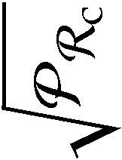
Firm Limit on Inflation
Curvature perturabation
n=1.28
1.35
1.39

Slide 26
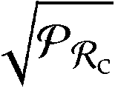
Being Speculative
If the sub-GeV pbar excess is real, allowed parameter region is very
restrictive
pbar visible
γ invisible
ℓ . 1 pm
Best-fit
α_{i} » 10⁻²⁷
¼ 0.05
Braneworld disfavoured?
Bess-Polar 2007 should give a hint

