Slide 1
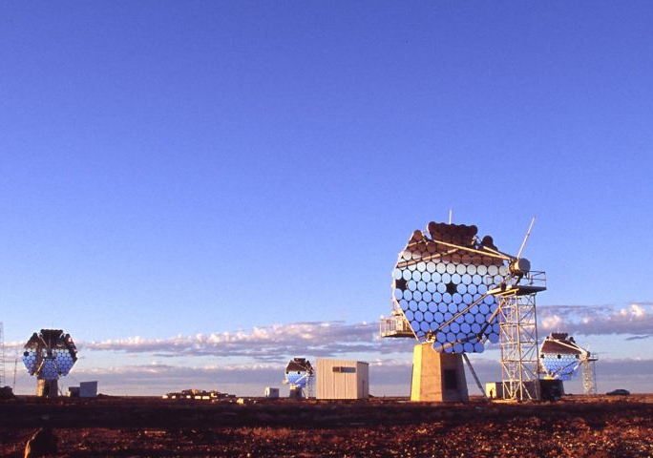
Recent Results from CANGAROO-III
Yohei Yukawa
for the CANGAROO Collaboration
International Conference on Topics in Astroparticle and Underground Physics (TAUP) 2007
Sendai, Japan September 14, 2007

Slide 2


Collaboration of Australia and Nippon for a GAmma Ray Observatory in the Outback
University of Adelaide
Australian National University
Ibaraki University
Ibaraki Prefectural University
Konan University
Kyoto University
STE Lab, Nagoya University
Kitasato University
Australia Telescope National Facility
Tokai University
ICRR, University of Tokyo
Yamagata University
Yamanashi Gakuin University
Hiroshima University
National Astronomical Observatory of Japan

Slide 3
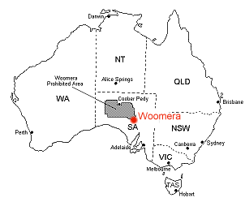
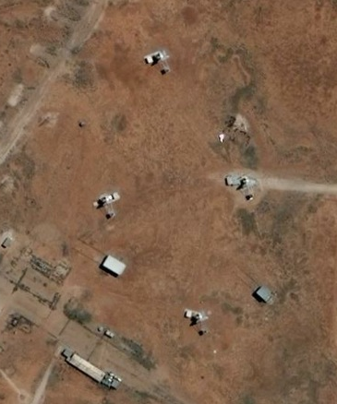
CANGAROO-III Telescopes
C-III is Ground-based TeV γ-ray detector
It consists of four atmospheric Cherenkov telescopes
The four-telescope array has been operational since 2004 March
C-III is located in the desert area of South Australia
It is suitable for southern-sky objects. (latitude 31 degree south)
136 47’E
31 06’S
160 m a.s.l.
T4
T1
T2
100m
T3
© Google map
Notes:
southern

Slide 4
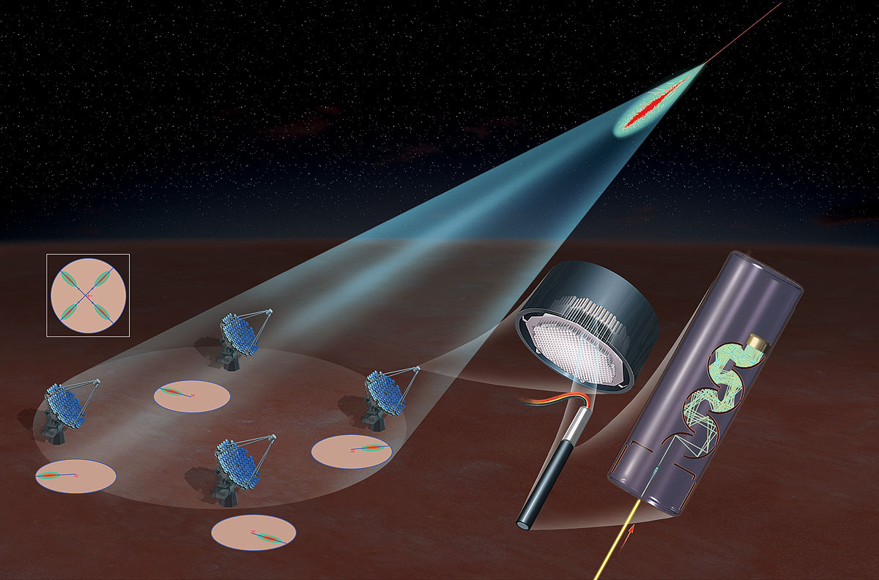
Schematic view of Cherenkov Telescopes
High energy cosmic-ray
Air shower
Cherenkov photons
10m optical telescopes
427 PMTs camera
Data acquisition system
Shower image is elliptic
We reconstruct the direction and energy of cosmic ray

Slide 5
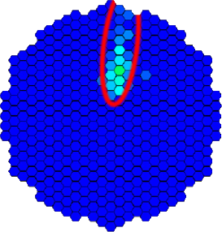
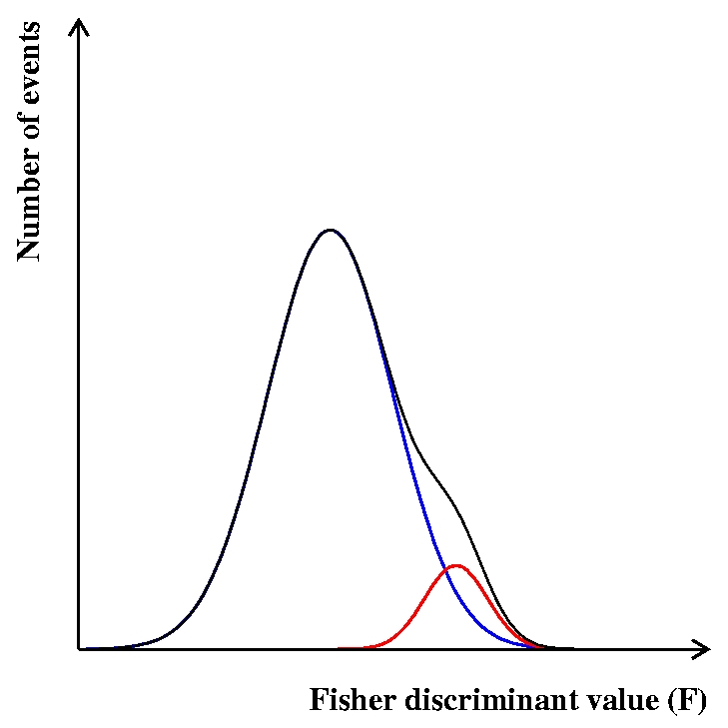
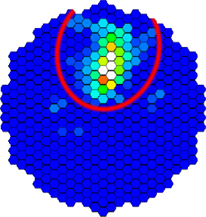
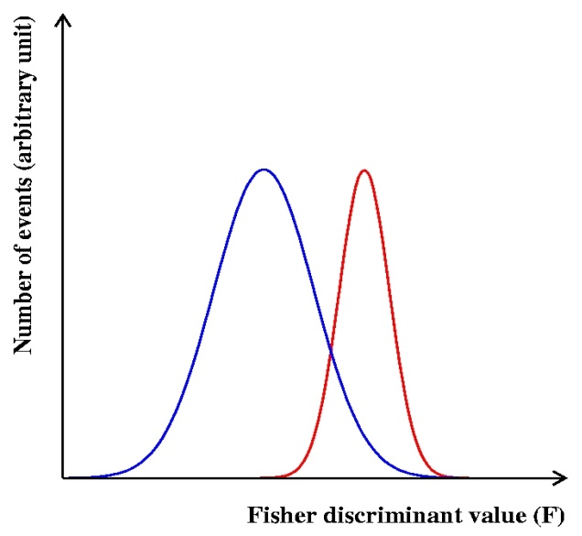
gamma / hadron separation
narrower
length
T2 Length
T3 Length
T4 Length
T2 Width
T3 Width
T4 Width
event by event
Details are written in
Count
width
Enomoto et.al., ApJ, 638, 397-408 (2006)
: ON-run
a few percent
of the events
: hadron (OFF)
moment fitting
: γ (MC)
γ-ray
n-th event
Fisher discriminant
The coefficients are automatically calculated to achieve best separation of gamma-ray events (MC) from hadronic events (OFF).
most of the events
hadronic
hadron
γ
If there is a gamma-ray source in On-source region, the gamma-ray event peak should remain in the distribution of Fisher discriminant.

Slide 6
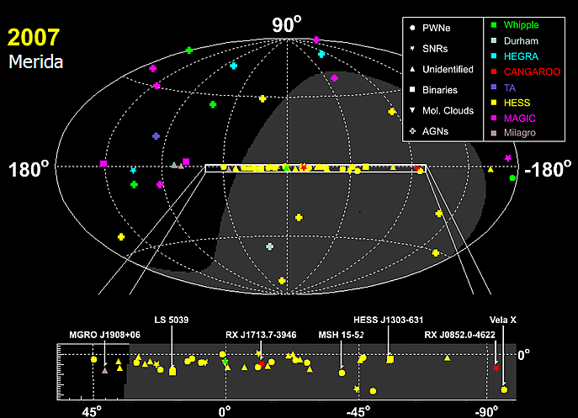
Recent results from CANGAROO-III
TeV Sky map 2007
I will present…
Jim Hinton, rapporteur talk, 30th ICRC, 2007
PKS 2155-304
Abell 3667/4038
Centaurus A
SN 1987A
MSH15-52
HESS J1804-216
Vela SNR

Slide 7
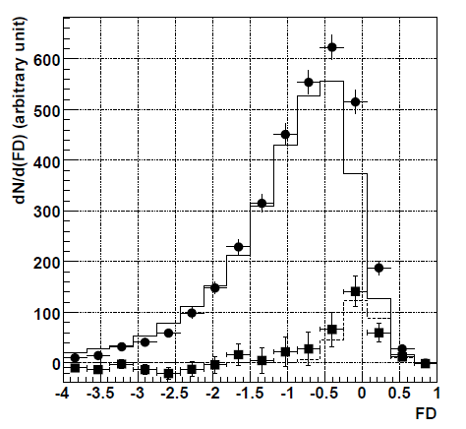
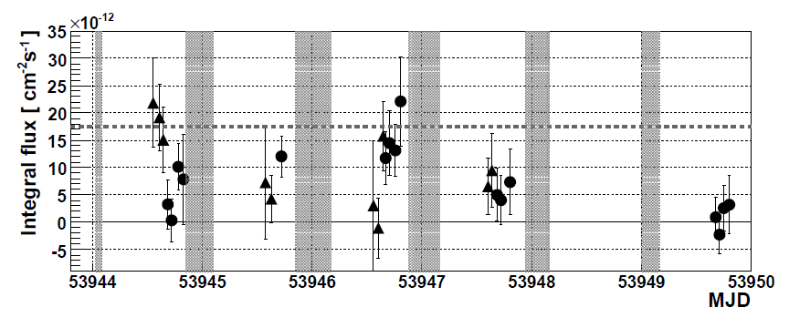
Active Galactic Nuclei: PKS 2155-304
Sakamoto et al., ICRC2007
Shaded area is the H.E.S.S. observation periods.
Time VS Integral flux
  Triangle: CANGAROO-III (T2-T4)
  Circle: CANGAROO-III (T2-T3-T4)
8 hours time difference between HESS and CANGAROO-III
γ-ray excess
two data set because of machine trouble
Time variable source
It was first detected in TeV γ-rays by Durham group in 1999.
HESS group reported historically high TeV flux in 2006 July
Follow up observation by CANGAROO-III.
  2006 July-August (just after HESS alert)
  Detected γ -ray excess

Slide 8

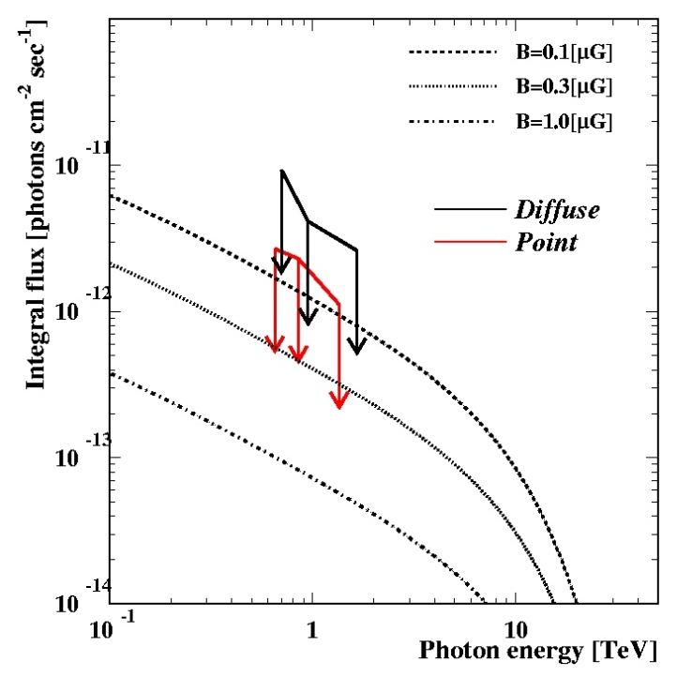
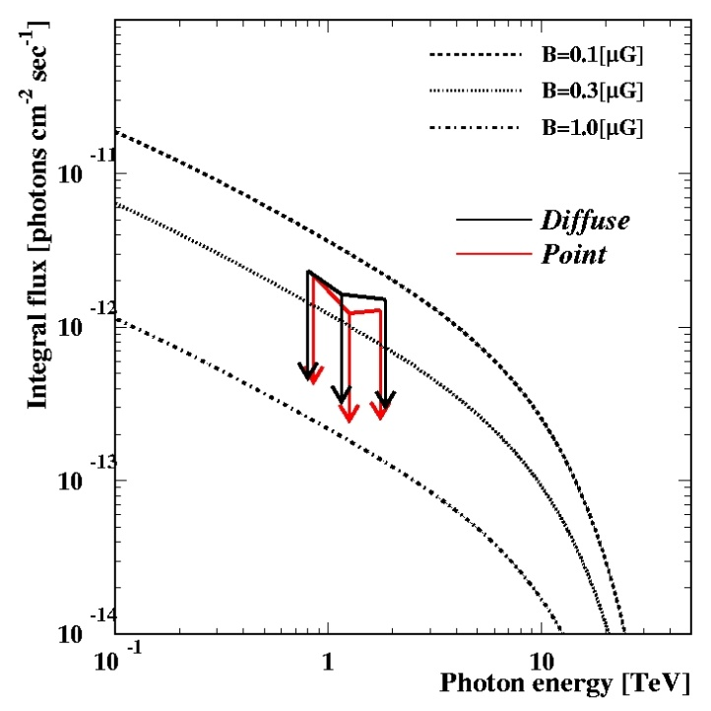
Clusters of Galaxies: Abell 3667 and 4038
Kiuchi et al., ICRC2007
p(UHE) + γ_{CΜΒ} → e⁺ + e⁻ + p
e± + γ_{CMB}→ γ (Inverse Compton scattering)
Motivation to observe Clusters of Galaxies
Abell 3667
Preliminary
Abell 4038
Clusters of Galaxies are candidate sites of the origin of ultra high energy cosmic rays.
There is a theory which predicts TeV gamma-ray emission from Clusters of Galaxies by proton-photon interaction.
[Inoue, Aharonian, & Sugiyama,ApJL,628,L9 (2005)]
0.1μG
diffuse:r<0.45゜
0.1μG
diffuse:r<0.28゜
0.3μG
0.3μG
1.0μG
CANGAROO-III Observation
1.0μG
We picked up two targets from the Abell catalog [Abell. G.O., Corwin, H.G., Jr., and Olowin, R.P. (1989) Ap.J.Suppl., 70, 1]
no gamma-ray excess
  within Virial radius from their centers
2 σ upper limits on their integral fluxes
Flux can limit magnetic field of the cluster under the model assumptions
Model : Inoue et al.
Model : Inoue et al.
z = 0.055
M ~ 2E15 M
X-ray + radio structure
2006 Jul-Aug
ON 29.7 / OFF 23.7 hours
z = 0.029 (as close as Coma cluster)
M ~ 5E14 M
2006 Aug-Sep
ON 23.8 / OFF 17.7 hours

Slide 9
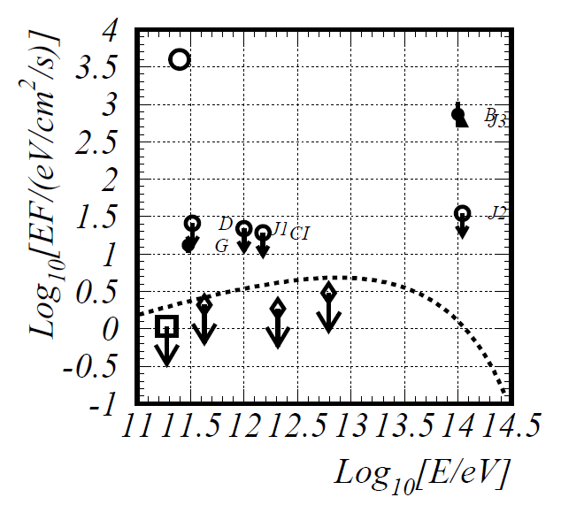
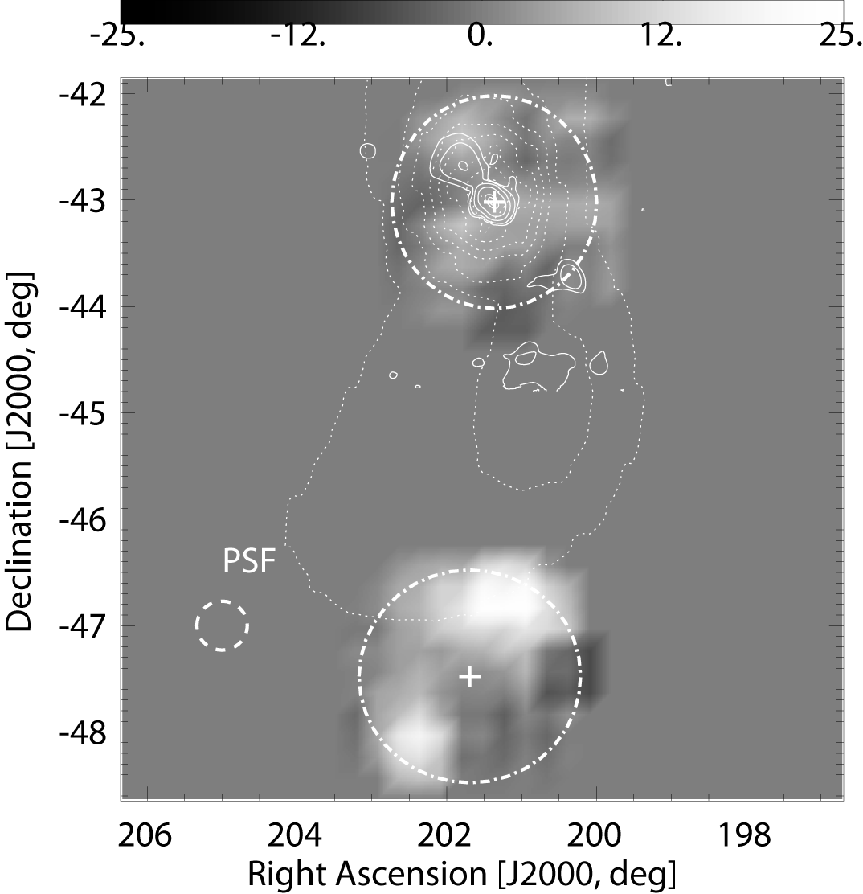
Active Galactic Nucleus: Centaurus A
S.Kabuki et al, ApJ, in press, Oct 1 issue 2007, rXiv.0706.0367
Nearby Radio-Loud AGN
HESS observation
  4 hours for jet region in 2004
  No excess: 2σ upper limit
CANGAROO-III observation
  10 hours in 2004
  No excess: 2σ upper limit
  Model comparison
Bai, J. M. & Lee, M. G., 2001, ApJ, 549, L173
Model prediction
HESS
CANGAROO-III
Spectral Energy Distribution for the jet region of Cen A
dotted line: TeV γ-ray spectrum by inverse Compton scattering
when we assume the total energy of electrons is 10⁵⁴ erg
Excess Count Map

Slide 10
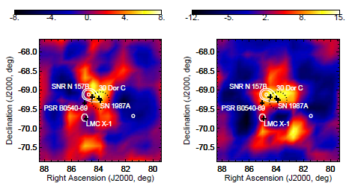
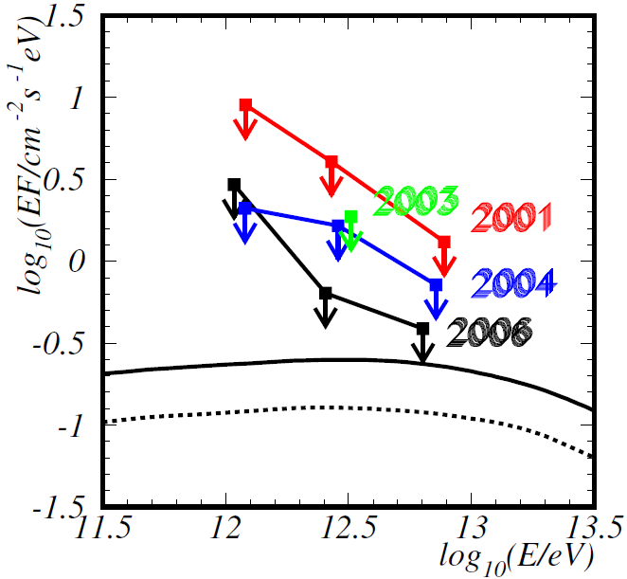
Super Nova: 1987A
R.Enomoto et al, ApJ, in press, Dec 10 issue 2007, arXiv:0709.1320
Decreasing upper limits and increasing model prediction will intersect near future.
2004
2006
Excess Count Map
prediction for 2009 sep
There is a prediction of TeV gamma-ray from SN1987A increasing with time after explosion.[Berezhko & Ksenofontov (2006)]
HESS observation in 2003
  No excess: 2σ upper limit
CANGAROO observation
  CANGAROO-II in 2001
  CANGAROO-III in 2004 and 2006
  We had no excess in 2001, 2004 and 2006, including some other candidate sources in this region of Large Magellanic Cloud.
prediction for 2006 obs + 100 day.
Spectral energy distribution
for the SN1987A
Red: CANGAROO-II
Green: HESS
Blue & Black: CANGAROO-III
Model: Berezhko & Ksenofontov (2006)

Slide 11
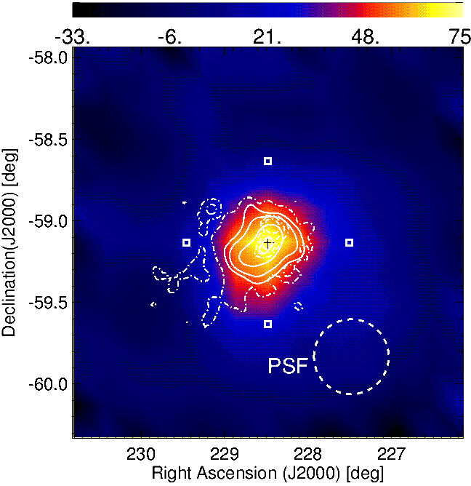
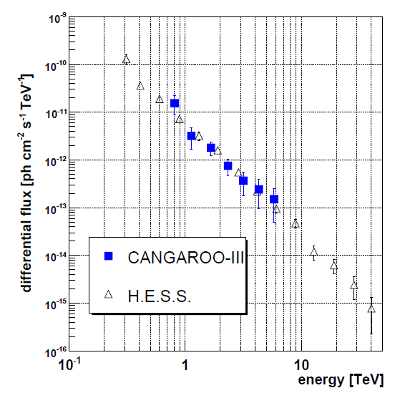
Pulsar Wind Nebula: MSH15-52
Nakamori et al., ICRC2007
(preliminary)
Excess Count Map
Solid:H.E.S.S.
Dashed:ROSAT
y’
ϕ
x’
TeV γ emission was detected by HESS group in 2004
Follow up observation by CANGAROO-III
  From 2006 April to June
  48.6 hours data and 582 excess events (7.6σ)
  Morphology and flux were consistent with H.E.S.S.

Slide 12
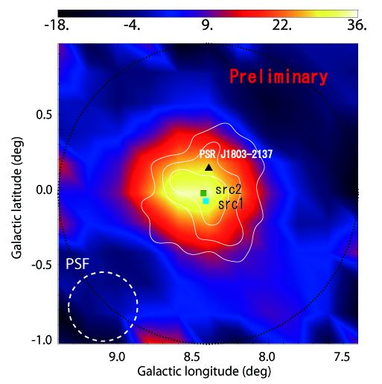
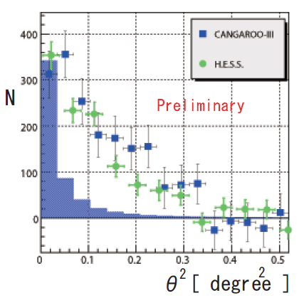
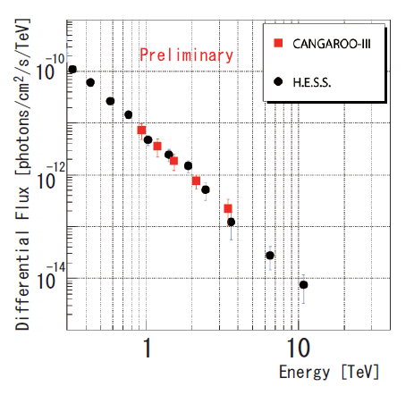
Unidentified source: HESS J1804-216
Higashi et al, ICRC2007
preliminary
solid:H.E.S.S.
Suzaku sources
radial profile r²(deg²) VS count
blue region: our PSF
Differencial flux
This object was found by HESS galactic plane survey in 2004
Follow up observation by CANGAROO-III
  2006 Jun-Aug
  62.5 hours data and 920 events (10.5σ)
  Morphology and flux were consistent with H.E.S.S.
  Two Suzaku sources

Slide 13
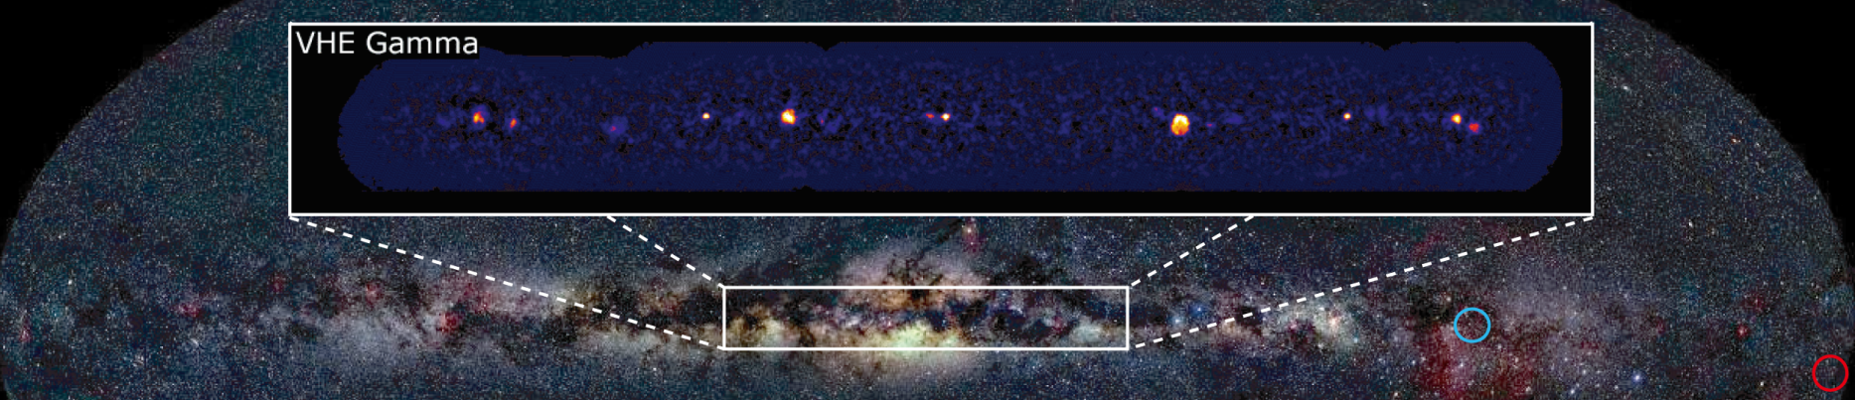
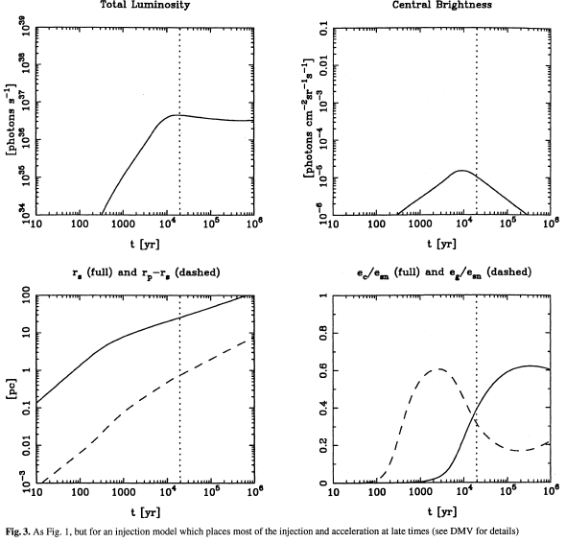
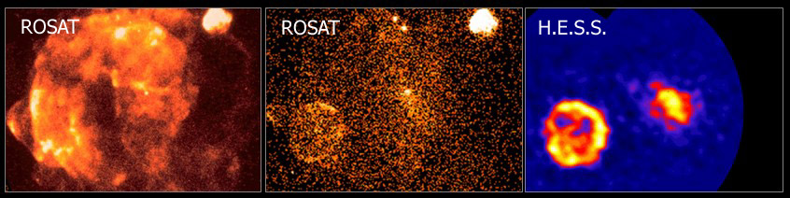
Vela Super Nova Remnant
10 k year -> Sedov phase
Optical: ©2000 Axel Mellinger
VHE Gamma: HESS Galactic Survey
soft X
hard X
HESS TeV γ
Drury,Aharonian,Voelk A&A 287,959p(1994)
http://www.mpi-hd.mpg.de/hfm/HESS/public/som/Som_5_06.htm
SNR itself is very large (φ_{D}=6 deg.)
The age of Vela SNR is about 10 thousand-year-old and the distance is 250 pc.
Two known TeV γ-ray sources (Vela X and RX J0852.0-4622) in this region.
We had scanning observations of the Vela region, including these known sources.
We want to investigate whether background field is zero or not.

Slide 14
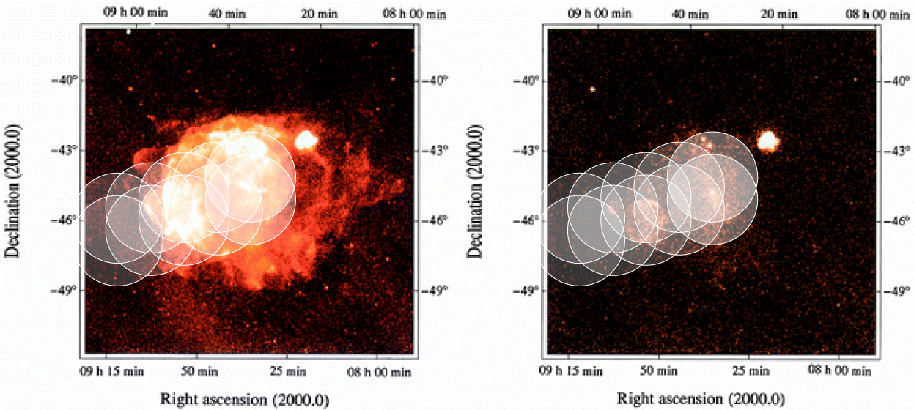
Observation
Vela PWN
4
5
2
3
1
RX J0852.0-4622
soft X
hard X
From 2006 January to 2006 March
Wobble Mode
B. Aschenbach, "Discovery of a Young Nearby Supernova Remnant", Nature 396, November 1998
Observation Time
[Hours]
 | Region 1 | Region 2 | Region 3 | Region 4 | Region 5
Elevation > 64 deg. | 7.4 | 4.9 | 8.8 | 9.2 | 17.5
After Cloud Cut | 5.8 | 4.8 | 8.7 | 9.0 | 15.5
Observation hours are not uniform

Slide 15
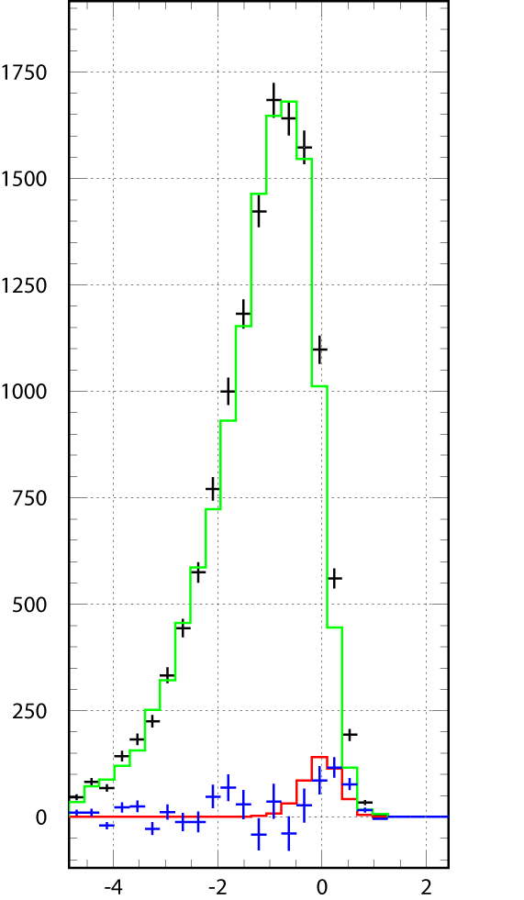
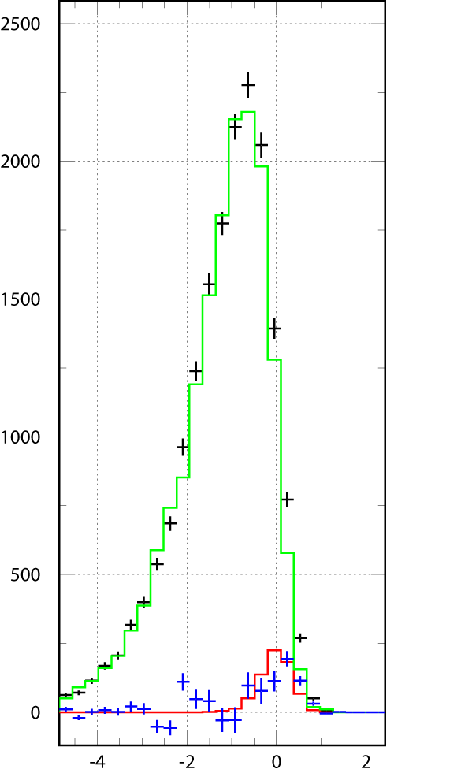
Known sources
Off
Vela X
RX J0852.0-4622
Preliminary
Preliminary
seen
within circle ->
<- within inner circle
Fisher Discriminant distribution

Slide 16
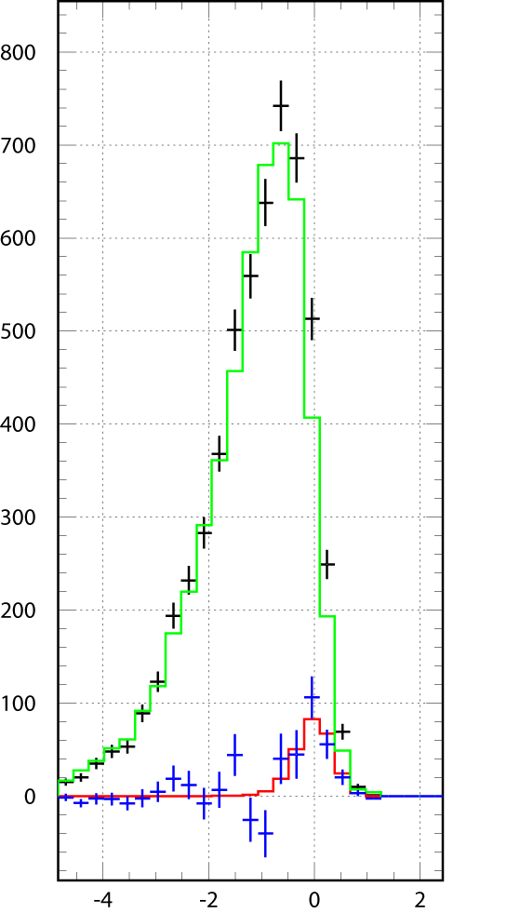
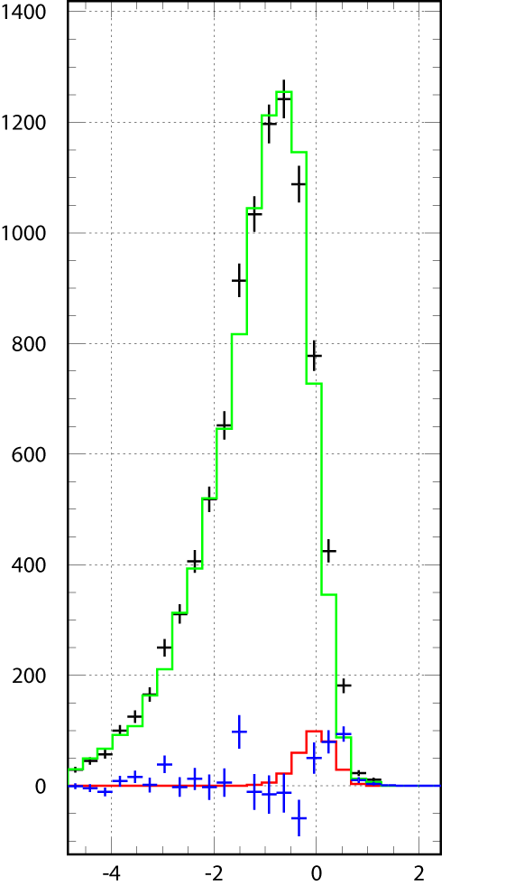
SNR
Vela PWN
Region 2
Off
Region 4
Preliminary
Preliminary
RX J0852.0-4622
γ-ray like
events still remain!
I need more study on the Vela SNR
Fisher Discriminant distribution

Slide 17
Summary
CANGAROO-III is ground-based TeV γ-ray detector.
  We are observing southern sky from South Australia.
I presented recent results from CANGAROO-III
  extragalactic sources
  PKS 2155-304: Detection
  Abell 3667/4038 Upper Limit
  Centaurus A Upper Limit
  SN 1987A Upper Limit
  galactic sources
  MSH15-52 Detection confirming HESS result
  HESS J1804-216 Detection confirming HESS result
  Vela SNR Scan Under analysis
    Vela PWN, RX J0852.0-4622: Seen
    SNR: Events still remain? -> I need more study on Vela SNR

Slide 18
My Personal Opinion
I need more study on Vela SNR
It might be necessary to be observed further for the Vela SNR
  GLAST, other IACTs, …
10 ky old SNR is dead or still alive?

Slide 19
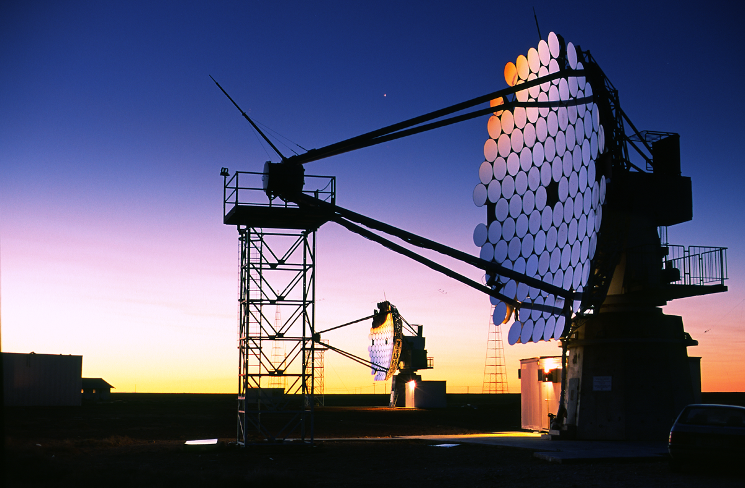
Thank you for your attention.

Slide 20
Recent Results of CANGAROO-III
Detection | Target | Category | Comment | Obs. Hours
✔ | MSH15-52 (PSR B1509-58) | PWN? | HESS source | 48.6
✔ | PKS2155-304 | AGN | HESS source | 10.5
✔ | HESS J1804-216 | UnID | HESS source | 62.5
✔ | HESS J1303-631 | UnID | HESS source | 35
U.L. | Abell 3667 and 4038 | Clusters of Galaxies |  | ON 29.7 / OFF 23.7 ON 23.8 / OFF 17.7
U.L. | Centaurus A | AGN | Old source | 10h
U.L. | ω Centaurus | Globular Cluster |  | 10h
U.L. | SN1987A | SNR | Young (20-year old) SNR | 10.5h(2004) 21.8h(2006)
U.L. | SNR N157B | SNR |  | 21.8h
U.L. | 30 Dor C | SNR
U.L. | LMC X-1 | LMC
U.L. | PSR B0540-69 | PSR

